Slide 1
CMPE 220
Class 20 – Case Studies
Notes:
Let’s talk about history.
California State Railroad Museum – 1976 - docents worked on original steam engines.

Slide 2
Case Study: The Linux Operating System
Linux as a case study of operating systems should be like a semester review.
We’ve pretty much been looking at Linux all along.
Designed by programmers for programmers, to be:
Simple
Elegant
Consistent
Powerful
Flexible
Open Source!

Slide 3
Linux versus POSIX
Linux, computer operating system created in the early 1990s by Finnish software engineer Linus Torvalds and the Free Software Foundation (FSF).
Linux is a “reverse engineered” version of Unix.

Slide 4
Linux versus POSIX
POSIX stands for Portable Operating System Interface. It’s a family of standards specified by IEEE for maintaining compatibility among operating systems.
Developed in the mid-to-late 1990s.
Any software that conforms to POSIX standards should be compatible with other operating systems that adhere to the POSIX standards.
Linux distros: Centos, Debian, Ubuntu, Fedora…
MacOS is POSIX compliant

Slide 5
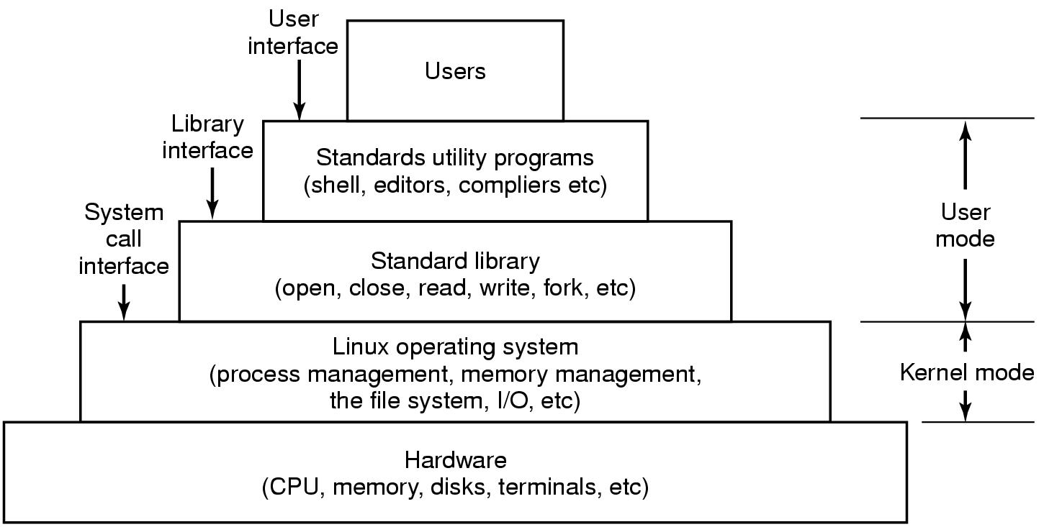
The Layers in a Linux System
Modern Operating Systems, 4th edition
by Andrew Tanenbaum & Herbert Bos
Pearson, 2014, ISBN 978-0133591620

Slide 6
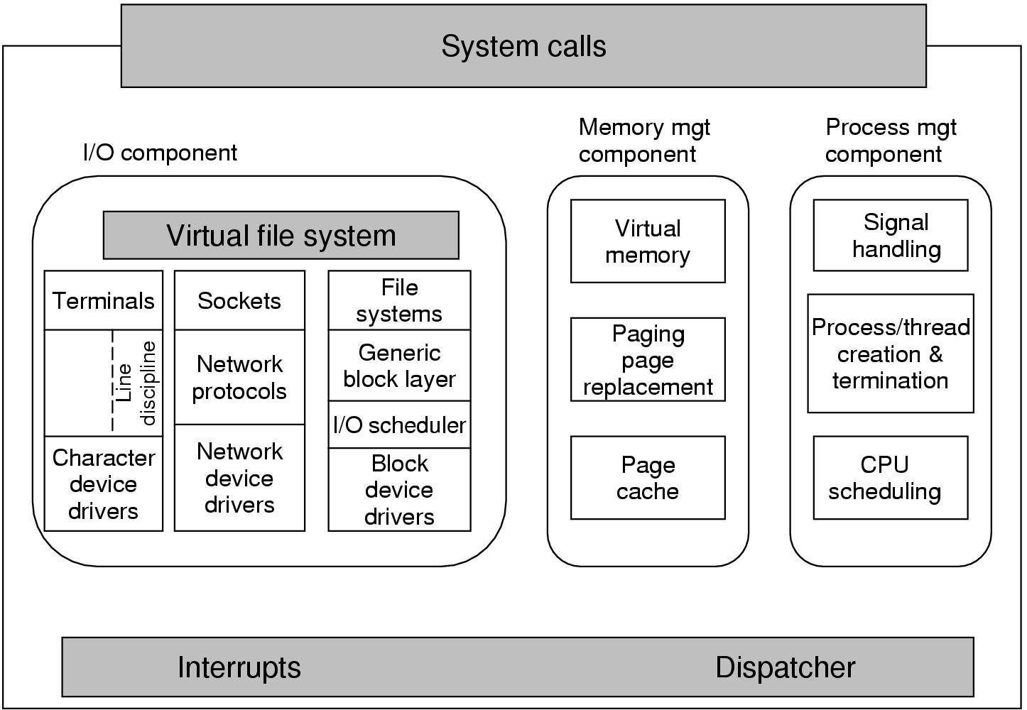
Structure of the Linux Kernel
Modern Operating Systems, 3rd ed.
Andrew Tanenbaum
(c) 2008 Prentice-Hall, Inc.. 0-13-600663-9
All rights reserved

Slide 7
Linux Processes and Threads
Linux tasks represent processes and threads.
Same internal process descriptor (PID):
Scheduling parameters (e.g. I/O wait, block)
Memory image
Signals & semaphors
Machine registers
System call state
File descriptor table
Accounting
Kernel stack
Miscellaneous

Slide 8
Linux Scheduler
Scheduling
FCFS and round-robin, as required by POSIX.
Priority-based
Priority ranges 0-99.
Pre-emptive Completely Fair Scheduler (CFS).
CFS always schedules the task which has the least amount of time left on the CPU.
nice command and system call can adjust a process’s priority up or down.

Slide 9
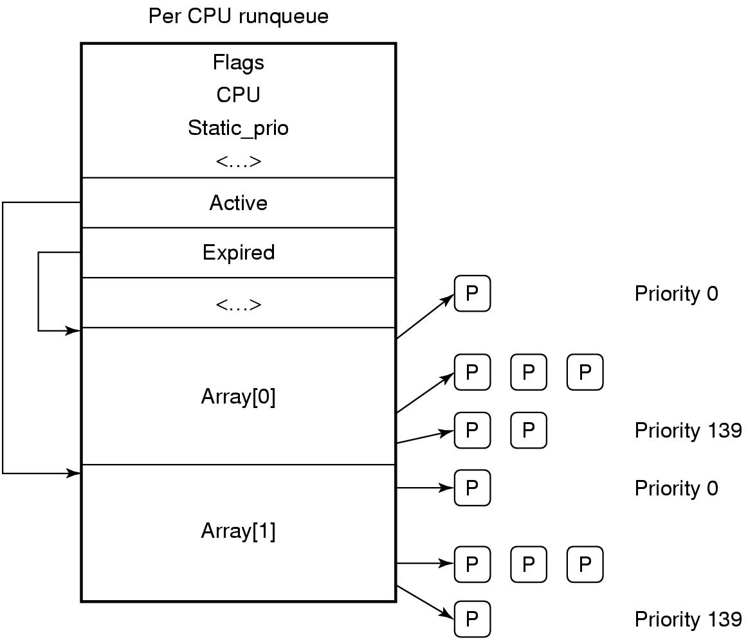
Linux Scheduler, cont’d
The runqueue is associated with each CPU.
Two arrays, active and expired.
Each contains 100 list heads, one per priority level.
Each list head points to a list of processes at that priority level.
Modern Operating Systems, 4th edition
by Andrew Tanenbaum & Herbert Bos
Pearson, 2014, ISBN 978-0133591620

Slide 10
Linux ext3 File System
Default block size is a function of the total size of the file system.
Block sizes of 1, 2, 4, and 8 KB supported.
To maintain high performance, cluster physically adjacent I/O requests.
Journaling file system
Transactions are logged to a journal.
Journal entries are replayed to the actual file system.
Journaling may improve file system performance.

Slide 11
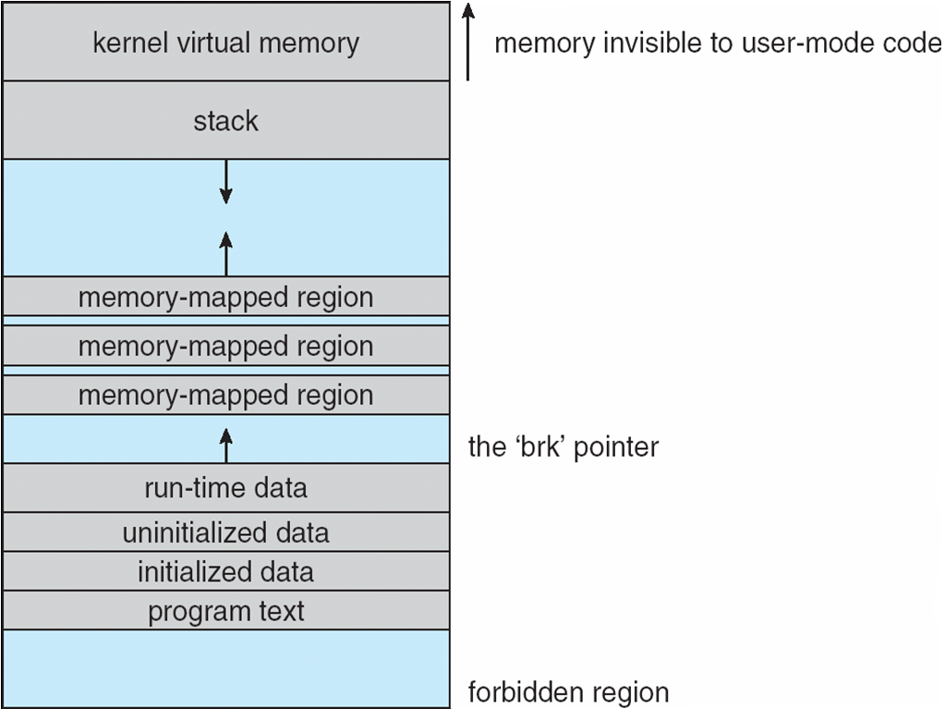
Linux Executable Files
Old format: a.out
New format: ELF (Executable and Linkable Format)
Memory layout:
Operating System Concepts, 10th edition
by Abraham Silberschatz, Greg Gagne, and Peter B. Galvin
Wiley, 2018, ISBN 978-1119456339

Slide 12
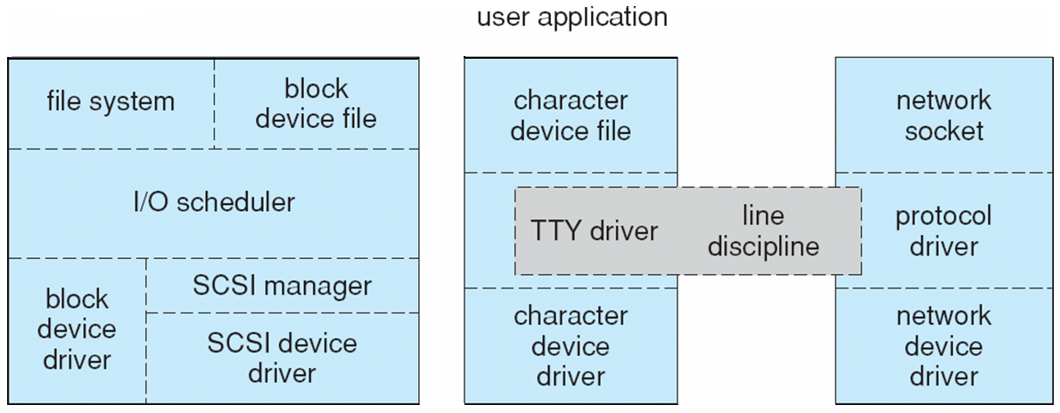
Linux I/O
Device-driver overall structure.
Block devices
Character devices
Network devices
Operating System Concepts, 10th edition
by Abraham Silberschatz, Greg Gagne, and Peter B. Galvin
Wiley, 2018, ISBN 978-1119456339

Slide 13
Linux I/O, cont’d
Block devices
Traditionally used C-SCAN (Circular Elevator) disk scheduling across all processes.
New algorithm: Completely Fair Queuing (CFQ)
One request list per process.
Each list maintained according to C-SCAN.
Lists are serviced round-robin.
Character devices
Line discipline interprets terminal device data.
Network devices

Slide 14
Linux Networking
Supports standard Internet protocols
UNIX-to-UNIX
Non-UNIX operating systems (standards!)
Three networking layers:
Socket interface (a socket is a combination of IP address and port)
Protocol drivers
Network-device drivers
User applications perform all networking requests through the socket interface

Slide 15
TCP/IP Protocol Suite
IP protocol implements routing between hosts.
UDP, TCP, and other protocols implemented on top of the routing protocol
UDP
Arbitrary individual datagrams between hosts (stateless)
TCP
Reliable connections between hosts
Guaranteed delivery of packets in order
Automatic retransmissions of lost packets

Slide 16
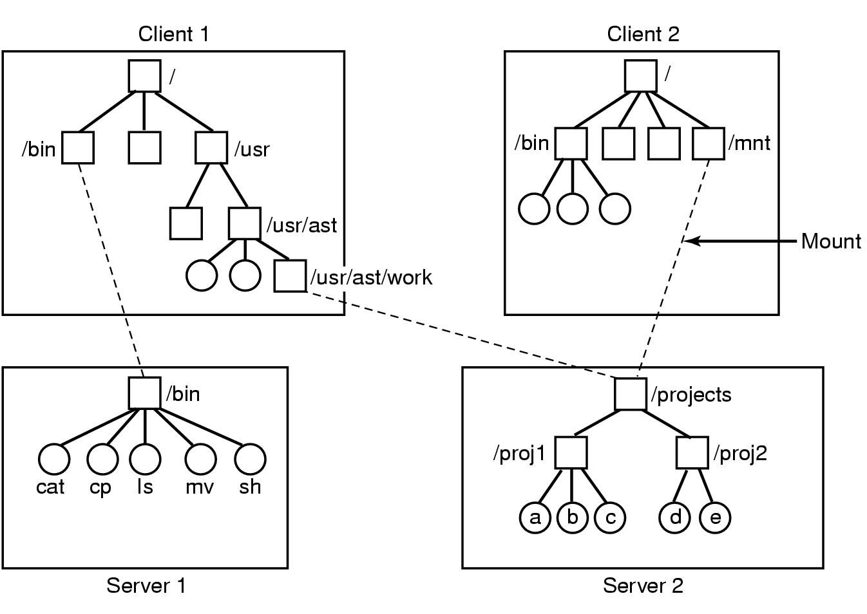
NFS (Network File System) Mounting
Sun Microsystems – mid 1980s

Slide 17
Microsoft Windows 10
Extensible and portable operating system.
Object Oriented: Kernel objects provide basic services.
Virtual memory, caching, preemptive scheduling
Elaborate security mechanisms to protect user data and to guarantee program integrity
Internationalization features
Sophisticated scheduling and memory management features
Feature-rich and expansive API programming environment for developers
Why is windows disparaged?

Slide 18
Why is Windows Disparaged?
History:
Microsoft MS-DOS and “The IBM PC”
Microsoft did not play well with others
Not standards compliant
Bill Gates was a jerk
Continuing issues with “being different”

Slide 19
Windows vs. Linux
Linux
Simple OS functions
Few parameters
Few examples of multiple ways to do something.
Kernel panic for a fatal error.
Windows
Comprehensive APIs with many parameters.
Several ways to do the same thing.
Mixed low-level and high-level functions.
Blue Screen of Death for a fatal error.

Slide 20
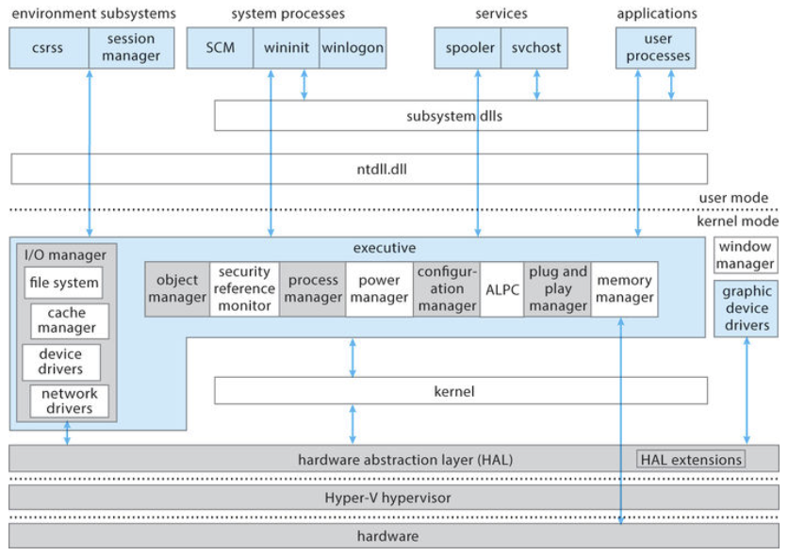
Windows 10 Architecture
Operating System Concepts, 10th edition
by Abraham Silberschatz, Greg Gagne, and Peter B. Galvin
Wiley, 2018, ISBN 978-1119456339

Slide 21
Windows 10 Dispatcher Objects
Dispatcher objects control dispatching and synchronization in the system:
event: records an event occurrence and synchronizes the event with some action
mutex: enforces mutual exclusion
semaphore: synchronizes threads
thread: scheduled by the kernel dispatcher
timer: keeps track of time and signals timeouts

Slide 22
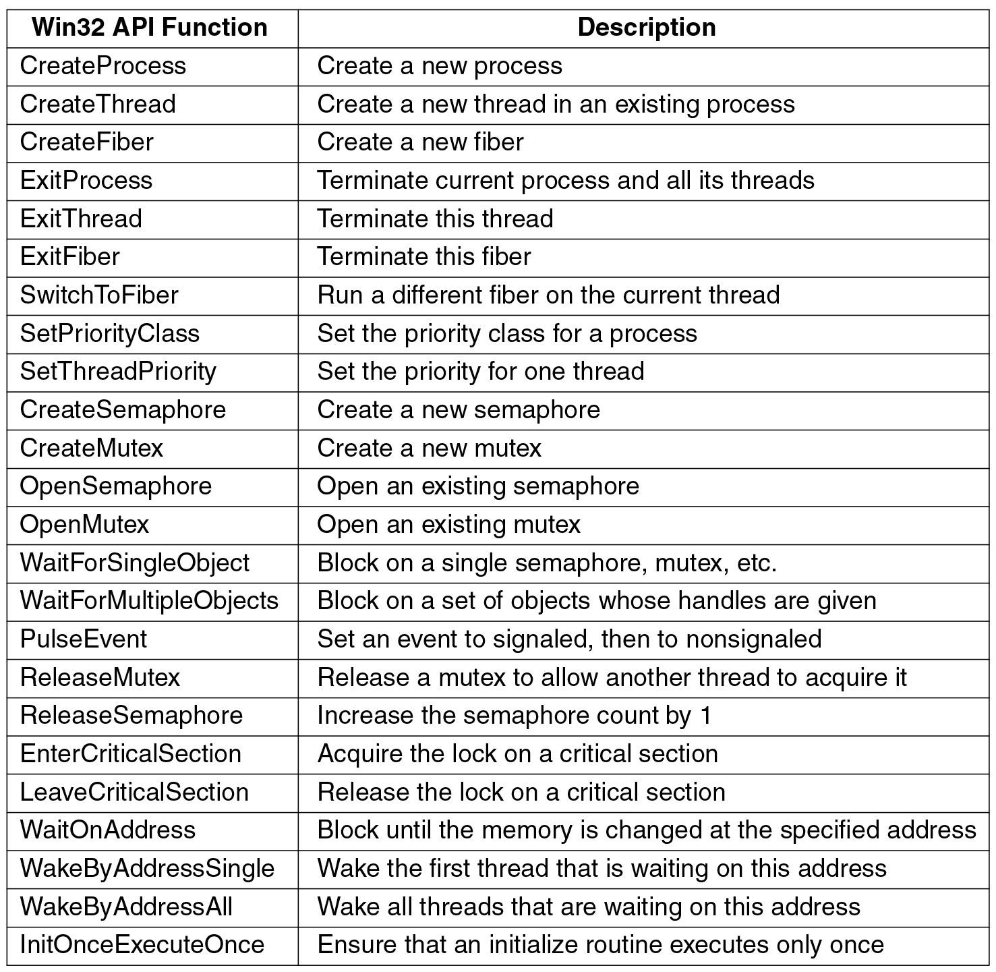
Processes and Threads, cont’d
Modern Operating Systems, 4th edition
by Andrew Tanenbaum & Herbert Bos
Pearson, 2014, ISBN 978-0133591620

Slide 23
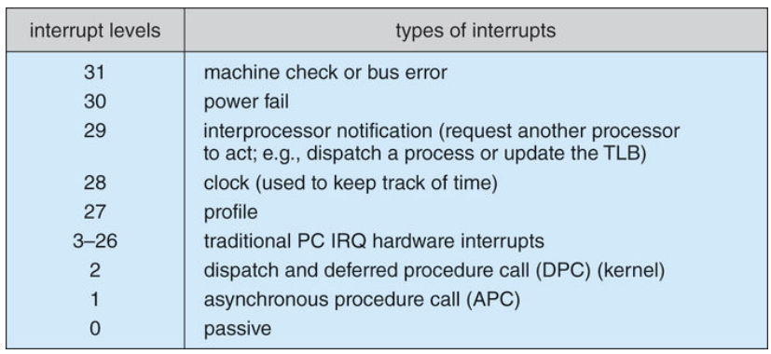
Interrupt Request Levels (IRQLs)
Operating System Concepts, 10th edition
by Abraham Silberschatz, Greg Gagne, and Peter B. Galvin
Wiley, 2018, ISBN 978-1119456339

Slide 24
Exceptions and Interrupts
The kernel dispatcher provides trap handling for exceptions and interrupts generated by hardware or software.
Integer or floating-point overflow
Integer or floating-point divide by zero
Illegal instruction
Data misalignment
Privileged instruction
Access violation
Paging file quota exceeded
Debugger breakpoint

Slide 25
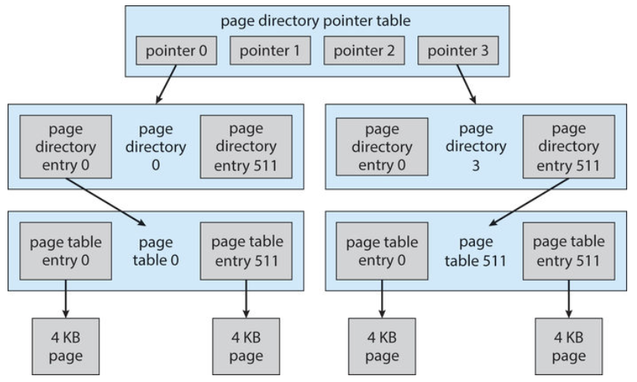
Virtual Memory
The page table layout can be expanded to manage ever larger physical memory sizes
Operating System Concepts, 10th edition
by Abraham Silberschatz, Greg Gagne, and Peter B. Galvin
Wiley, 2018, ISBN 978-1119456339

Slide 26
Android
Designed by Google to run on mobile devices.
NASA uses Android for its “cubesats”.
Based on the Linux kernel and facilities.
Much written in Java.
Combines open-source code with closed-source third-party applications.
Supports a wide variety of proprietary cloud services.
Google Play online store for Android apps.

Slide 27
Android Design Goals
Open-source platform for mobile devices
Support 3rd party apps with robust, stable API
3rd party apps compete on level playing field
Users need not deeply trust 3rd party apps
Support mobile user interaction
Manage app processes for users
Encourage apps to interoperate, collaborate
Full general-purpose OS

Slide 28
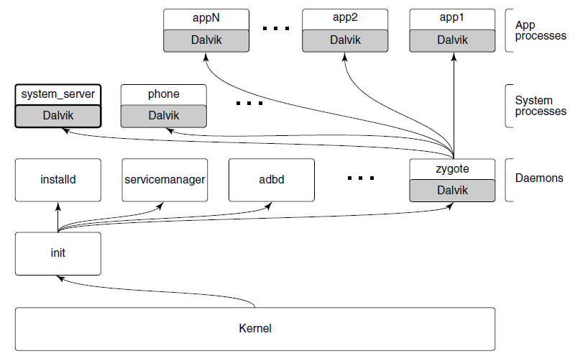
Android Architecture
Dalvik is a JVM
Modern Operating Systems, 4th edition
by Andrew Tanenbaum & Herbert Bos
Pearson, 2014, ISBN 978-0133591620

Slide 29
Android Architecture, cont'd
The init process starts Android daemons.
Focused on low-level functions such as managing file systems and hardware access.
Additional layer of processes that run Dalvik’s Java language environment.
Dalvik is a managed runtime environment.
Brought up by the zygote native daemon.
JVM bytecode is translated to Dalvik bytecode.

Slide 30
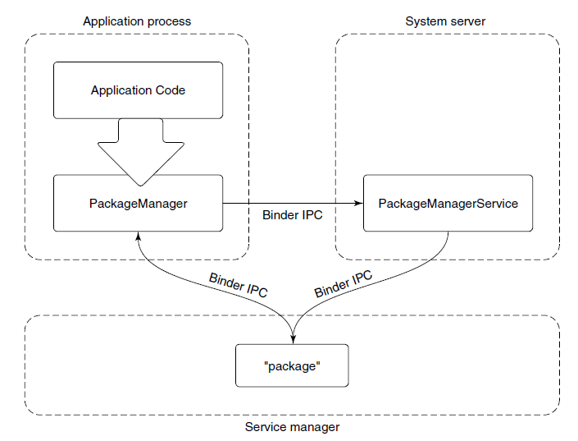
Android Application Framework
Typical design for Android framework APIs that interact with system services, such as the PackageManager class.
Modern Operating Systems, 4th edition
by Andrew Tanenbaum & Herbert Bos
Pearson, 2014, ISBN 978-0133591620

Slide 31
Package Manager Example
The package manager provides a framework API for apps to call in their local process.
The PackageManager class connects to the corresponding service in the system server.
The PackageManager makes calls on the service.
Calls are implemented as interprocess communication.
Android Binder IPC mechanism.

Slide 32
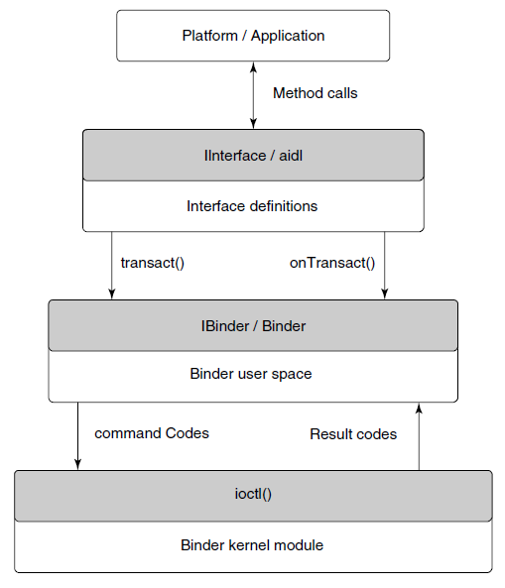
Binder IPC
Relies on remote procedure calls (RPC).
Modern Operating Systems, 4th edition
by Andrew Tanenbaum & Herbert Bos
Pearson, 2014, ISBN 978-0133591620

Slide 33
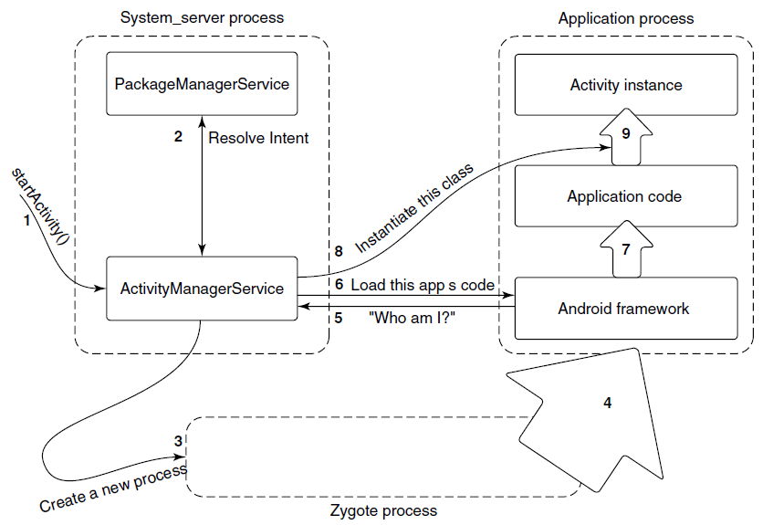
Launching a New Application Process
Modern Operating Systems, 4th edition
by Andrew Tanenbaum & Herbert Bos
Pearson, 2014, ISBN 978-0133591620

Slide 34
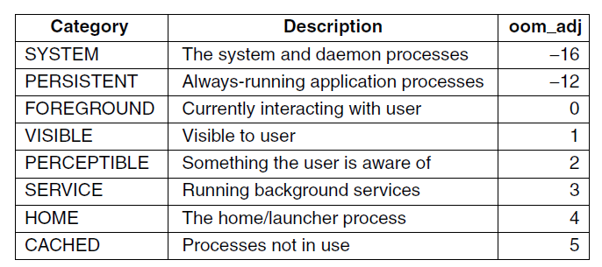
Process Lifecycle
Process importance categories.
oom_adj: a strict ordering to determine which processes to kill first in an out-of-memory situation.
Modern Operating Systems, 4th edition
by Andrew Tanenbaum & Herbert Bos
Pearson, 2014, ISBN 978-0133591620

